Slide 1
Predictive Data Locality Optimization for Higher-Order Tensor Computations
Tharindu R. Patabandi¹, Anand Venkat², Abhishek Kulkarni², Pushkar Ratnalikar², Mary Hall¹, Justin Gottschlich²
1. University of Utah, 2. Intel
The 5th Annual Symposium on Machine Programming
June 21, 2021

Slide 2
Introduction

Slide 3
Introduction
Optimizing compilers can generation code with high resource utilization (high-performance code)
Optimizing
compiler

Slide 4
Introduction
Computation
Optimizing compilers can generation code with high resource utilization (high-performance code)
Consume unoptimized program implementations expressed in general purpose languages or DSLs.
for(…)
for(…)
C=A+B
…
Optimizing
compiler

Slide 5
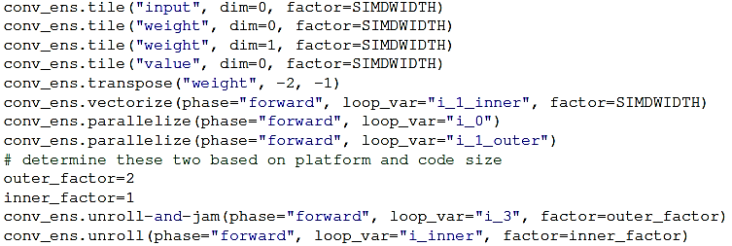
Introduction
Computation
Optimizing compilers can generation code with high resource utilization (high-performance code)
Consume unoptimized program implementations expressed in general purpose languages or DSLs.
Code transformations
alter the execution order of statements in a loop nest while preserving data dependences
Transformation Recipe (schedule), a sequence of transformations targeted for obtaining a loop nest with specific execution behavior
for(…)
for(…)
C=A+B
…
Optimizing
compiler
interchange
tile
unroll/unroll-and-jam
vectorize
parallelize
fusion
Transformations
13
4

Slide 6
Introduction
Computation
Optimizing compilers can generation code with high resource utilization (high-performance code)
Consume unoptimized program implementations expressed in general purpose languages or DSLs.
Code transformations
alter the execution order of statements in a loop nest while preserving data dependences
Transformation Recipe (schedule), a sequence of transformations targeted for obtaining a loop nest with specific execution behavior
Schedules aim to find an optimal mapping of code on to the underlying hardware
for(…)
for(…)
C=A+B
…
x86
- SIMD, AVX, SSE
- Cores/Threads
GPU
- warp
- thread/block
Register/Cache/Memory
ILP
Optimizing
compiler
interchange
tile
unroll/unroll-and-jam
vectorize
parallelize
fusion
Architecture
Transformations
13
4

Slide 7
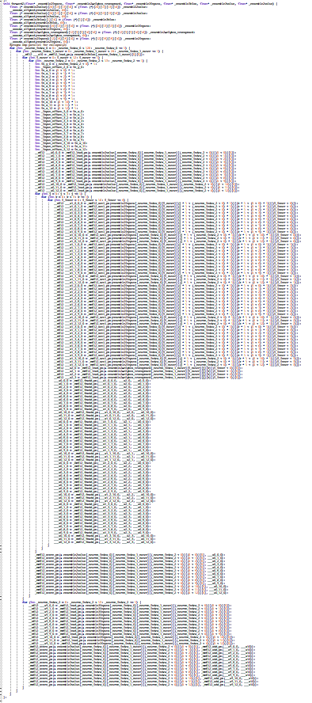
Introduction
Computation
Optimizing compilers can generation code with high resource utilization (high-performance code)
Consume unoptimized program implementations expressed in general purpose languages or DSLs.
Code transformations
alter the execution order of statements in a loop nest while preserving data dependences
Transformation Recipe (schedule), a sequence of transformations targeted for obtaining a loop nest with specific execution behavior
Schedules aim to find an optimal mapping of code on to the underlying hardware
for(…)
for(…)
C=A+B
…
x86
- SIMD, AVX, SSE
- Cores/Threads
GPU
- warp
- thread/block
Register/Cache/Memory
ILP
Optimizing
compiler
interchange
tile
unroll/unroll-and-jam
vectorize
parallelize
fusion
Architecture
Transformations
13
4
Generated C++

Slide 8
Introduction
Computation
Optimizing compilers can generation code with high resource utilization (high-performance code)
Consume unoptimized program implementations expressed in general purpose languages or DSLs.
Code transformations
alter the execution order of statements in a loop nest while preserving data dependences
Transformation Recipe (schedule), a sequence of transformations targeted for obtaining a loop nest with specific execution behavior
Schedules aim to find an optimal mapping of code on to the underlying hardware
While compilers generate highly optimized target-specific code given a schedule, automatically generating good schedules remains an open problem
for(…)
for(…)
C=A+B
…
x86
- SIMD, AVX, SSE
- Cores/Threads
GPU
- warp
- thread/block
Register/Cache/Memory
ILP
Optimizing
compiler
interchange
tile
unroll/unroll-and-jam
vectorize
parallelize
fusion
Architecture
Transformations
13
4
Generated C++

Slide 9
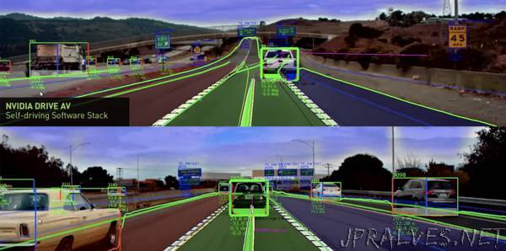
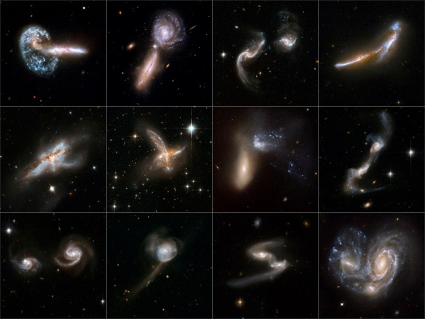
ML Research and Applications
ML research is at an exciting place
https://jpralves.net/post/2019/04/25/tesla-raises-the-bar-for-self-driving-carmakers.html
https://hubblesite.org/contents/news-releases/2008/news-2008-16.html
Hu, X., Luo, W., Hu, J. et al. Brain SegNet: 3D local refinement network for brain lesion segmentation. BMC Med Imaging 20, 17 (2020). https://doi.org/10.1186/s12880-020-0409-2
https://www.wired.it/mobile/app/2019/07/11/google-translate-fotocamera

Slide 10
ML Research and Applications
ML research is at an exciting place
Convolutional Neural Networks (CNN) have become popular in computer vision and its numerous application domains
https://jpralves.net/post/2019/04/25/tesla-raises-the-bar-for-self-driving-carmakers.html
https://hubblesite.org/contents/news-releases/2008/news-2008-16.html
Hu, X., Luo, W., Hu, J. et al. Brain SegNet: 3D local refinement network for brain lesion segmentation. BMC Med Imaging 20, 17 (2020). https://doi.org/10.1186/s12880-020-0409-2
https://www.wired.it/mobile/app/2019/07/11/google-translate-fotocamera

Slide 11
ML Research and Applications
ML research is at an exciting place
Convolutional Neural Networks (CNN) have become popular in computer vision and its numerous application domains
forward
backward
weight update

Slide 12
ML Research and Applications
ML research is at an exciting place
Convolutional Neural Networks (CNN) have become popular in computer vision and its numerous application domains
forward
backward
weight update

Slide 13
ML Research and Applications
ML research is at an exciting place
Convolutional Neural Networks (CNN) have become popular in computer vision and its numerous application domains
forward
backward
weight update

Slide 14
ML Research and Applications
ML research is at an exciting place
Convolutional Neural Networks (CNN) have become popular in computer vision and its numerous application domains
forward
backward
weight update

Slide 15
ML Research and Applications
ML research is at an exciting place
Convolutional Neural Networks (CNN) have become popular in computer vision and its numerous application domains
>90% time spent on Convolution^{[1]}
forward
backward
weight update
[1] Cong, Jason, and Bingjun Xiao. "Minimizing computation in convolutional neural networks." International conference on artificial neural networks. Springer, Cham, 2014.

Slide 16
ML Research and Applications
ML research is at an exciting place
Convolutional Neural Networks (CNN) have become popular in computer vision and its numerous application domains
>90% time spent on Convolution^{[1]}
Efficient CNN implementations are important
forward
backward
weight update
[1] Cong, Jason, and Bingjun Xiao. "Minimizing computation in convolutional neural networks." International conference on artificial neural networks. Springer, Cham, 2014.

Slide 17
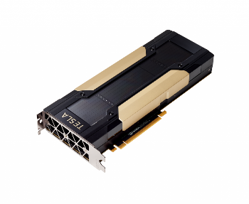
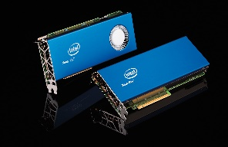
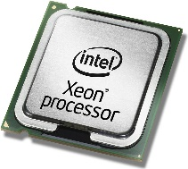
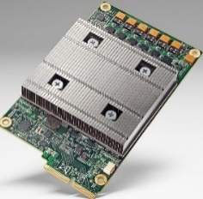
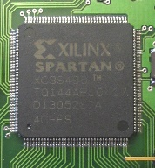
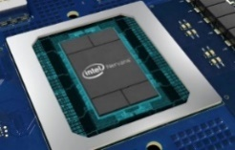
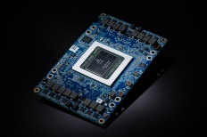
Efficient Implementation of Convolution
Library based implementations
optimization primitives that would replace (parts of) operators in the network with pre-tuned kernels
GEMM (im2col,..), FFT, Winograd, direct formulations
Compiler driven implementations are becoming popular
Flexibility and modular optimization
nvcc/PTX
ICC
HLO
Graph
Layout
Loop
Transform
Arch.
specific
OneDNN
nGraph
Tiramisu

Slide 18
Contributions

Slide 19
Contributions
A domain-specific optimizing compiler for 2D Convolutions

Slide 20
Contributions
A domain-specific optimizing compiler for 2D Convolutions
A machine learning model to predict the performance of different loop permutations
Code features: loop bounds, array accesses, reuse, and dependence information

Slide 21
Contributions
A domain-specific optimizing compiler for 2D Convolutions
A machine learning model to predict the performance of different loop permutations
Code features: loop bounds, array accesses, reuse, and dependence information
A code generation system implemented using LLVM/MLIR that achieves performance competitive with state-of-the-art hand-optimized oneDNN.
~90% of oneDNN’s best performing implementation

Slide 22
Impact of Loop Permutation
frequency
perf. interval (GFLOPS/s)

Slide 23
Impact of Loop Permutation
frequency
perf. interval (GFLOPS/s)
1.46%
3.54%
0.71%

Slide 24
System Components
Conv-FP MLIR
Conv-BP MLIR
Conv-WU MLIR

Slide 25
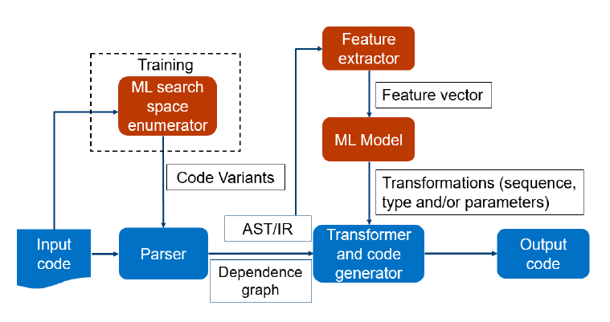
System Components
Combines ML training and inference with the traditional compiler workflow
Conv-FP MLIR
Conv-BP MLIR
Conv-WU MLIR

Slide 26
System Components
Combines ML training and inference with the traditional compiler workflow
During training, a space of code variants is explored
guided by analytical heuristics to reduce cost
Conv-FP MLIR
Conv-BP MLIR
Conv-WU MLIR

Slide 27
System Components
Combines ML training and inference with the traditional compiler workflow
During training, a space of code variants is explored
guided by analytical heuristics to reduce cost
Static features are extracted from the IR
loop bounds, data reuse based on dependence analysis, …
MLIR affine, std dialects
Conv-FP MLIR
Conv-BP MLIR
Conv-WU MLIR

Slide 28
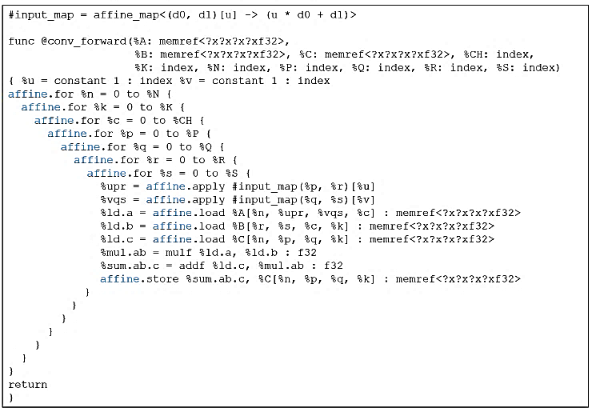
System Components
Combines ML training and inference with the traditional compiler workflow
During training, a space of code variants is explored
guided by analytical heuristics to reduce cost
Static features are extracted from the IR
loop bounds, data reuse based on dependence analysis, …
MLIR affine, std dialects
Conv-FP MLIR
Conv-BP MLIR
Conv-WU MLIR

Slide 29
System Components
Combines ML training and inference with the traditional compiler workflow
During training, a space of code variants is explored
guided by analytical heuristics to reduce cost
Static features are extracted from the IR
loop bounds, data reuse based on dependence analysis, …
MLIR affine, std dialects
During inference, make compile-time predictions to leverage loop optimization decisions
such as, best loop permutation
Conv-FP MLIR
Conv-BP MLIR
Conv-WU MLIR

Slide 30
Reuse Types
for(int n=0;n<N;n++)
for(int c=0;c<C;c++)
for(int k=0;k<K;k++)
for(int p=0;p<P;p++)
for(int q=0;q<Q;q++)
for(int r=0;r<R;r++)
for(int s=0;s<S;s++)
C[n][p][q][k] += A[n][p+r][q+s][c]*B[r][s][c][k]
 | A | B | C
N | spatial | temporal | spatial
C | spatial | spatial | temporal
K | temporal | partial | partial
P | stencil | temporal | spatial
Q | stencil | temporal | spatial
R | stencil | spatial | temporal
S | stencil | spatial | temporal
$$A∈ℝ^{NHWC}, B∈ℝ^{RSCK}, C∈ℝ^{NPQK}$$

Slide 31
Reuse Types
for(int n=0;n<N;n++)
for(int c=0;c<C;c++)
for(int k=0;k<K;k++)
for(int p=0;p<P;p++)
for(int q=0;q<Q;q++)
for(int r=0;r<R;r++)
for(int s=0;s<S;s++)
C[n][p][q][k] += A[n][p+r][q+s][c]*B[r][s][c][k]
 | A | B | C
N | spatial | temporal | spatial
C | spatial | spatial | temporal
K | temporal | partial | partial
P | stencil | temporal | spatial
Q | stencil | temporal | spatial
R | stencil | spatial | temporal
S | stencil | spatial | temporal
$$A∈ℝ^{NHWC}, B∈ℝ^{RSCK}, C∈ℝ^{NPQK}$$

Slide 32
Reuse Types
for(int n=0;n<N;n++)
for(int c=0;c<C;c++)
for(int k=0;k<K;k++)
for(int p=0;p<P;p++)
for(int q=0;q<Q;q++)
for(int r=0;r<R;r++)
for(int s=0;s<S;s++)
C[n][p][q][k] += A[n][p+r][q+s][c]*B[r][s][c][k]
 | A | B | C
N | spatial | temporal | spatial
C | spatial | spatial | temporal
K | temporal | partial | partial
P | stencil | temporal | spatial
Q | stencil | temporal | spatial
R | stencil | spatial | temporal
S | stencil | spatial | temporal
$$A∈ℝ^{NHWC}, B∈ℝ^{RSCK}, C∈ℝ^{NPQK}$$

Slide 33
Permutation and Locality

Slide 34
Permutation and Locality
for(int n=0;n<N;n++)
for(int c=0;c<C;c++)
for(int k=0;k<K;k++)
for(int p=0;p<P;p++)
for(int q=0;q<Q;q++)
for(int r=0;r<R;r++)
for(int s=0;s<S;s++)
C[n][p][q][k] += A[n][p+r][q+s][c]*B[r][s][c][k]
$$A∈ℝ^{NHWC}, B∈ℝ^{RSCK}, C∈ℝ^{NPQK}$$

Slide 35
Permutation and Locality
for(int n=0;n<N;n++)
for(int c=0;c<C;c++)
for(int k=0;k<K;k++)
for(int p=0;p<P;p++)
for(int q=0;q<Q;q++)
for(int r=0;r<R;r++)
for(int s=0;s<S;s++)
C[n][p][q][k] += A[n][p+r][q+s][c]*B[r][s][c][k]
$$A∈ℝ^{NHWC}, B∈ℝ^{RSCK}, C∈ℝ^{NPQK}$$

Slide 36
Permutation and Locality
for(int n=0;n<N;n++)
for(int c=0;c<C;c++)
for(int k=0;k<K;k++)
for(int p=0;p<P;p++)
for(int q=0;q<Q;q++)
for(int r=0;r<R;r++)
for(int s=0;s<S;s++)
C[n][p][q][k] += A[n][p+r][q+s][c]*B[r][s][c][k]
Tensor C
p=0
q=0
p=0
q=1
p=0
q=2
p=1
q=0
p=1
q=1
…
…
 |  |  |  |  |  |  |  |  |  |  |  |  |  |  |  |  |  |  |  | … | …
$$A∈ℝ^{NHWC}, B∈ℝ^{RSCK}, C∈ℝ^{NPQK}$$

Slide 37
Permutation and Locality
for(int n=0;n<N;n++)
for(int c=0;c<C;c++)
for(int k=0;k<K;k++)
for(int p=0;p<P;p++)
for(int q=0;q<Q;q++)
for(int r=0;r<R;r++)
for(int s=0;s<S;s++)
C[n][p][q][k] += A[n][p+r][q+s][c]*B[r][s][c][k]
Tensor C
p=0
q=0
p=0
q=1
p=0
q=2
p=1
q=0
p=1
q=1
…
…
 |  |  |  |  |  |  |  |  |  |  |  |  |  |  |  |  |  |  |  | … | …
$$A∈ℝ^{NHWC}, B∈ℝ^{RSCK}, C∈ℝ^{NPQK}$$

Slide 38
Permutation and Locality
for(int n=0;n<N;n++)
for(int c=0;c<C;c++)
for(int k=0;k<K;k++)
for(int p=0;p<P;p++)
for(int q=0;q<Q;q++)
for(int r=0;r<R;r++)
for(int s=0;s<S;s++)
C[n][p][q][k] += A[n][p+r][q+s][c]*B[r][s][c][k]
Tensor C
p=0
q=0
p=0
q=1
p=0
q=2
p=1
q=0
p=1
q=1
…
…
 |  |  |  |  |  |  |  |  |  |  |  |  |  |  |  |  |  |  |  | … | …
$$A∈ℝ^{NHWC}, B∈ℝ^{RSCK}, C∈ℝ^{NPQK}$$

Slide 39
Permutation and Locality
for(int n=0;n<N;n++)
for(int c=0;c<C;c++)
for(int k=0;k<K;k++)
for(int p=0;p<P;p++)
for(int q=0;q<Q;q++)
for(int r=0;r<R;r++)
for(int s=0;s<S;s++)
C[n][p][q][k] += A[n][p+r][q+s][c]*B[r][s][c][k]
Tensor C
p=0
q=0
p=0
q=1
p=0
q=2
p=1
q=0
p=1
q=1
…
…
 |  |  |  |  |  |  |  |  |  |  |  |  |  |  |  |  |  |  |  | … | …
$$A∈ℝ^{NHWC}, B∈ℝ^{RSCK}, C∈ℝ^{NPQK}$$

Slide 40
Permutation and Locality
for(int n=0;n<N;n++)
for(int c=0;c<C;c++)
for(int k=0;k<K;k++)
for(int p=0;p<P;p++)
for(int q=0;q<Q;q++)
for(int r=0;r<R;r++)
for(int s=0;s<S;s++)
C[n][p][q][k] += A[n][p+r][q+s][c]*B[r][s][c][k]
Tensor C
p=0
q=0
p=0
q=1
p=0
q=2
p=1
q=0
p=1
q=1
…
…
 |  |  |  |  |  |  |  |  |  |  |  |  |  |  |  |  |  |  |  | … | …
$$A∈ℝ^{NHWC}, B∈ℝ^{RSCK}, C∈ℝ^{NPQK}$$

Slide 41
Permutation and Locality
for(int n=0;n<N;n++)
for(int c=0;c<C;c++)
for(int k=0;k<K;k++)
for(int p=0;p<P;p++)
for(int q=0;q<Q;q++)
for(int r=0;r<R;r++)
for(int s=0;s<S;s++)
C[n][p][q][k] += A[n][p+r][q+s][c]*B[r][s][c][k]
Tensor C
p=0
q=0
p=0
q=1
p=0
q=2
p=1
q=0
p=1
q=1
…
…
 |  |  |  |  |  |  |  |  |  |  |  |  |  |  |  |  |  |  |  | … | …
$$A∈ℝ^{NHWC}, B∈ℝ^{RSCK}, C∈ℝ^{NPQK}$$

Slide 42
Permutation and Locality
for(int n=0;n<N;n++)
for(int c=0;c<C;c++)
for(int k=0;k<K;k++)
for(int p=0;p<P;p++)
for(int q=0;q<Q;q++)
for(int r=0;r<R;r++)
for(int s=0;s<S;s++)
C[n][p][q][k] += A[n][p+r][q+s][c]*B[r][s][c][k]
Tensor C
p=0
q=0
p=0
q=1
p=0
q=2
p=1
q=0
p=1
q=1
…
…
 |  |  |  |  |  |  |  |  |  |  |  |  |  |  |  |  |  |  |  | … | …
$$A∈ℝ^{NHWC}, B∈ℝ^{RSCK}, C∈ℝ^{NPQK}$$

Slide 43
Permutation and Locality
for(int n=0;n<N;n++)
for(int c=0;c<C;c++)
for(int k=0;k<K;k++)
for(int p=0;p<P;p++)
for(int q=0;q<Q;q++)
for(int r=0;r<R;r++)
for(int s=0;s<S;s++)
C[n][p][q][k] += A[n][p+r][q+s][c]*B[r][s][c][k]
for(int n=0;n<N;n++)
for(int c=0;c<C;c++)
for(int p=0;p<P;p++)
for(int q=0;q<Q;q++)
for(int r=0;r<R;r++)
for(int s=0;s<S;s++)
for(int k=0;k<K;k++)
C[n][p][q][k] += A[n][p+r][q+s][c]*B[r][s][c][k]
Tensor C
p=0
q=0
p=0
q=1
p=0
q=2
p=1
q=0
p=1
q=1
…
…
 |  |  |  |  |  |  |  |  |  |  |  |  |  |  |  |  |  |  |  | … | …
$$A∈ℝ^{NHWC}, B∈ℝ^{RSCK}, C∈ℝ^{NPQK}$$

Slide 44
Permutation and Locality
for(int n=0;n<N;n++)
for(int c=0;c<C;c++)
for(int k=0;k<K;k++)
for(int p=0;p<P;p++)
for(int q=0;q<Q;q++)
for(int r=0;r<R;r++)
for(int s=0;s<S;s++)
C[n][p][q][k] += A[n][p+r][q+s][c]*B[r][s][c][k]
for(int n=0;n<N;n++)
for(int c=0;c<C;c++)
for(int p=0;p<P;p++)
for(int q=0;q<Q;q++)
for(int r=0;r<R;r++)
for(int s=0;s<S;s++)
for(int k=0;k<K;k++)
C[n][p][q][k] += A[n][p+r][q+s][c]*B[r][s][c][k]
Tensor C
p=0
q=0
p=0
q=1
p=0
q=2
p=1
q=0
p=1
q=1
…
…
p=0
q=0
p=0
q=1
p=0
q=2
p=1
q=0
p=1
q=1
…
…
 |  |  |  |  |  |  |  |  |  |  |  |  |  |  |  |  |  |  |  | … | …
 |  |  |  |  |  |  |  |  |  |  |  |  |  |  |  |  |  |  |  | … | …
$$A∈ℝ^{NHWC}, B∈ℝ^{RSCK}, C∈ℝ^{NPQK}$$

Slide 45
Permutation and Locality
for(int n=0;n<N;n++)
for(int c=0;c<C;c++)
for(int k=0;k<K;k++)
for(int p=0;p<P;p++)
for(int q=0;q<Q;q++)
for(int r=0;r<R;r++)
for(int s=0;s<S;s++)
C[n][p][q][k] += A[n][p+r][q+s][c]*B[r][s][c][k]
for(int n=0;n<N;n++)
for(int c=0;c<C;c++)
for(int p=0;p<P;p++)
for(int q=0;q<Q;q++)
for(int r=0;r<R;r++)
for(int s=0;s<S;s++)
for(int k=0;k<K;k++)
C[n][p][q][k] += A[n][p+r][q+s][c]*B[r][s][c][k]
Tensor C
p=0
q=0
p=0
q=1
p=0
q=2
p=1
q=0
p=1
q=1
…
…
p=0
q=0
p=0
q=1
p=0
q=2
p=1
q=0
p=1
q=1
…
…
 |  |  |  |  |  |  |  |  |  |  |  |  |  |  |  |  |  |  |  | … | …
 |  |  |  |  |  |  |  |  |  |  |  |  |  |  |  |  |  |  |  | … | …
$$A∈ℝ^{NHWC}, B∈ℝ^{RSCK}, C∈ℝ^{NPQK}$$

Slide 46
Permutation and Locality
for(int n=0;n<N;n++)
for(int c=0;c<C;c++)
for(int k=0;k<K;k++)
for(int p=0;p<P;p++)
for(int q=0;q<Q;q++)
for(int r=0;r<R;r++)
for(int s=0;s<S;s++)
C[n][p][q][k] += A[n][p+r][q+s][c]*B[r][s][c][k]
for(int n=0;n<N;n++)
for(int c=0;c<C;c++)
for(int p=0;p<P;p++)
for(int q=0;q<Q;q++)
for(int r=0;r<R;r++)
for(int s=0;s<S;s++)
for(int k=0;k<K;k++)
C[n][p][q][k] += A[n][p+r][q+s][c]*B[r][s][c][k]
Tensor C
p=0
q=0
p=0
q=1
p=0
q=2
p=1
q=0
p=1
q=1
…
…
p=0
q=0
p=0
q=1
p=0
q=2
p=1
q=0
p=1
q=1
…
…
 |  |  |  |  |  |  |  |  |  |  |  |  |  |  |  |  |  |  |  | … | …
 |  |  |  |  |  |  |  |  |  |  |  |  |  |  |  |  |  |  |  | … | …
$$A∈ℝ^{NHWC}, B∈ℝ^{RSCK}, C∈ℝ^{NPQK}$$

Slide 47
Permutation and Locality
for(int n=0;n<N;n++)
for(int c=0;c<C;c++)
for(int k=0;k<K;k++)
for(int p=0;p<P;p++)
for(int q=0;q<Q;q++)
for(int r=0;r<R;r++)
for(int s=0;s<S;s++)
C[n][p][q][k] += A[n][p+r][q+s][c]*B[r][s][c][k]
for(int n=0;n<N;n++)
for(int c=0;c<C;c++)
for(int p=0;p<P;p++)
for(int q=0;q<Q;q++)
for(int r=0;r<R;r++)
for(int s=0;s<S;s++)
for(int k=0;k<K;k++)
C[n][p][q][k] += A[n][p+r][q+s][c]*B[r][s][c][k]
Tensor C
p=0
q=0
p=0
q=1
p=0
q=2
p=1
q=0
p=1
q=1
…
…
p=0
q=0
p=0
q=1
p=0
q=2
p=1
q=0
p=1
q=1
…
…
 |  |  |  |  |  |  |  |  |  |  |  |  |  |  |  |  |  |  |  | … | …
 |  |  |  |  |  |  |  |  |  |  |  |  |  |  |  |  |  |  |  | … | …
$$A∈ℝ^{NHWC}, B∈ℝ^{RSCK}, C∈ℝ^{NPQK}$$

Slide 48
Permutation and Locality
for(int n=0;n<N;n++)
for(int c=0;c<C;c++)
for(int k=0;k<K;k++)
for(int p=0;p<P;p++)
for(int q=0;q<Q;q++)
for(int r=0;r<R;r++)
for(int s=0;s<S;s++)
C[n][p][q][k] += A[n][p+r][q+s][c]*B[r][s][c][k]
for(int n=0;n<N;n++)
for(int c=0;c<C;c++)
for(int p=0;p<P;p++)
for(int q=0;q<Q;q++)
for(int r=0;r<R;r++)
for(int s=0;s<S;s++)
for(int k=0;k<K;k++)
C[n][p][q][k] += A[n][p+r][q+s][c]*B[r][s][c][k]
Tensor C
p=0
q=0
p=0
q=1
p=0
q=2
p=1
q=0
p=1
q=1
…
…
p=0
q=0
p=0
q=1
p=0
q=2
p=1
q=0
p=1
q=1
…
…
 |  |  |  |  |  |  |  |  |  |  |  |  |  |  |  |  |  |  |  | … | …
 |  |  |  |  |  |  |  |  |  |  |  |  |  |  |  |  |  |  |  | … | …
$$A∈ℝ^{NHWC}, B∈ℝ^{RSCK}, C∈ℝ^{NPQK}$$

Slide 49
Permutation and Locality
for(int n=0;n<N;n++)
for(int c=0;c<C;c++)
for(int k=0;k<K;k++)
for(int p=0;p<P;p++)
for(int q=0;q<Q;q++)
for(int r=0;r<R;r++)
for(int s=0;s<S;s++)
C[n][p][q][k] += A[n][p+r][q+s][c]*B[r][s][c][k]
for(int n=0;n<N;n++)
for(int c=0;c<C;c++)
for(int p=0;p<P;p++)
for(int q=0;q<Q;q++)
for(int r=0;r<R;r++)
for(int s=0;s<S;s++)
for(int k=0;k<K;k++)
C[n][p][q][k] += A[n][p+r][q+s][c]*B[r][s][c][k]
Tensor C
p=0
q=0
p=0
q=1
p=0
q=2
p=1
q=0
p=1
q=1
…
…
p=0
q=0
p=0
q=1
p=0
q=2
p=1
q=0
p=1
q=1
…
…
 |  |  |  |  |  |  |  |  |  |  |  |  |  |  |  |  |  |  |  | … | …
 |  |  |  |  |  |  |  |  |  |  |  |  |  |  |  |  |  |  |  | … | …
$$A∈ℝ^{NHWC}, B∈ℝ^{RSCK}, C∈ℝ^{NPQK}$$

Slide 50
Permutation and Locality
for(int n=0;n<N;n++)
for(int c=0;c<C;c++)
for(int k=0;k<K;k++)
for(int p=0;p<P;p++)
for(int q=0;q<Q;q++)
for(int r=0;r<R;r++)
for(int s=0;s<S;s++)
C[n][p][q][k] += A[n][p+r][q+s][c]*B[r][s][c][k]
for(int n=0;n<N;n++)
for(int c=0;c<C;c++)
for(int p=0;p<P;p++)
for(int q=0;q<Q;q++)
for(int r=0;r<R;r++)
for(int s=0;s<S;s++)
for(int k=0;k<K;k++)
C[n][p][q][k] += A[n][p+r][q+s][c]*B[r][s][c][k]
Tensor C
p=0
q=0
p=0
q=1
p=0
q=2
p=1
q=0
p=1
q=1
…
…
p=0
q=0
p=0
q=1
p=0
q=2
p=1
q=0
p=1
q=1
…
…
 |  |  |  |  |  |  |  |  |  |  |  |  |  |  |  |  |  |  |  | … | …
 |  |  |  |  |  |  |  |  |  |  |  |  |  |  |  |  |  |  |  | … | …
$$A∈ℝ^{NHWC}, B∈ℝ^{RSCK}, C∈ℝ^{NPQK}$$

Slide 51
Feature Representation
Loop bounds
determines the size of memory footprint and the amount of computation required
Data reuse information
determines what loops are carrying data reuse for each tensor
affects locality based on the type of reuse available
Transform the FV to reflect loop permutation
7
7x3
$$b_{0}^{}$$ | $$b_{1}^{}$$ | $$b_{2}^{}$$ | $$b_{3}^{}$$ | $$b_{4}^{}$$ | $$b_{5}^{}$$ | $$b_{6}^{}$$ | $$d_{0}^{A}$$ | $$d_{1}^{A}$$ | $$d_{2}^{A}$$ | $$d_{3}^{A}$$ | $$d_{4}^{A}$$ | $$d_{5}^{A}$$ | $$d_{6}^{A}$$ | $$d_{0}^{B}$$ | $$d_{1}^{B}$$ | $$d_{2}^{B}$$ | $$d_{3}^{B}$$ | $$d_{4}^{B}$$ | $$d_{5}^{B}$$ | $$d_{6}^{B}$$ | $$d_{0}^{C}$$ | $$d_{1}^{C}$$ | $$d_{2}^{C}$$ | $$d_{3}^{C}$$ | $$d_{4}^{C}$$ | $$d_{5}^{C}$$ | $$d_{6}^{C}$$
N C K H W R S
A
B
C
Bounds
Reuse

Slide 52
Feature Representation
Loop bounds
determines the size of memory footprint and the amount of computation required
Data reuse information
determines what loops are carrying data reuse for each tensor
affects locality based on the type of reuse available
Transform the FV to reflect loop permutation
7
7x3
$$b_{0}^{}$$ | $$b_{1}^{}$$ | $$b_{2}^{}$$ | $$b_{3}^{}$$ | $$b_{4}^{}$$ | $$b_{5}^{}$$ | $$b_{6}^{}$$ | $$d_{0}^{A}$$ | $$d_{1}^{A}$$ | $$d_{2}^{A}$$ | $$d_{3}^{A}$$ | $$d_{4}^{A}$$ | $$d_{5}^{A}$$ | $$d_{6}^{A}$$ | $$d_{0}^{B}$$ | $$d_{1}^{B}$$ | $$d_{2}^{B}$$ | $$d_{3}^{B}$$ | $$d_{4}^{B}$$ | $$d_{5}^{B}$$ | $$d_{6}^{B}$$ | $$d_{0}^{C}$$ | $$d_{1}^{C}$$ | $$d_{2}^{C}$$ | $$d_{3}^{C}$$ | $$d_{4}^{C}$$ | $$d_{5}^{C}$$ | $$d_{6}^{C}$$
N C K H W R S
A
B
C
Bounds
Reuse
Each loop bound i is projected onto a position vector v_{i}
permutation-sensitive
positional encoding
$$b_{0}^{}$$ | 0 | 0 | 0 | 0 | 0 | 0 | 0 | $$b_{1}^{}$$ | 0 | 0 | 0 | 0 | 0 | 0 | 0 | $$b_{2}^{}$$ | 0 | 0 | 0 | 0 | 0 | 0 | 0 | $$b_{3}^{}$$ | 0 | 0 | 0 | 0 | 0 | 0 | 0 | $$b_{4}^{}$$ | 0 | 0 | 0 | 0 | 0 | 0 | 0 | $$b_{5}^{}$$ | 0 | 0 | 0 | 0 | 0 | 0 | 0 | $$b_{6}^{}$$

Slide 53
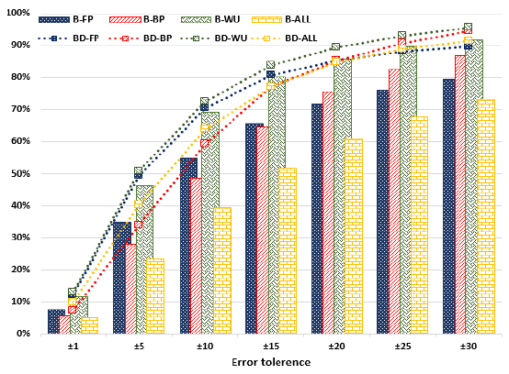
Regression Model
5-deep FC-ANN
ReLU(Linear(196x60)) → ReLU(Linear(60x30)) →ReLU(Linear(30x15)) → ReLU(Linear(15x7)) → Linear(7x1)
Adam, $lr=1×{10}^{−5}$
$\left|model\left(x\right)−\hat{y}\right|≤α→model(x)$ is correct within $±α$ accuracy
Bounds model (B-model)
$$b_{0}^{}$$ | $$b_{1}^{}$$ | $$b_{2}^{}$$ | $$b_{3}^{}$$ | $$b_{4}^{}$$ | $$b_{5}^{}$$ | $$b_{6}^{}$$
Bounds-Dependence model (BD-model)
$$b_{0}^{}$$ | $$b_{1}^{}$$ | $$b_{2}^{}$$ | $$b_{3}^{}$$ | $$b_{4}^{}$$ | $$b_{5}^{}$$ | $$b_{6}^{}$$ | $$d_{0}^{A}$$ | $$d_{1}^{A}$$ | $$d_{2}^{A}$$ | $$d_{3}^{A}$$ | $$d_{4}^{A}$$ | $$d_{5}^{A}$$ | $$d_{6}^{A}$$ | $$d_{0}^{B}$$ | $$d_{1}^{B}$$ | $$d_{2}^{B}$$ | $$d_{3}^{B}$$ | $$d_{4}^{B}$$ | $$d_{5}^{B}$$ | $$d_{6}^{B}$$ | $$d_{0}^{C}$$ | $$d_{1}^{C}$$ | $$d_{2}^{C}$$ | $$d_{3}^{C}$$ | $$d_{4}^{C}$$ | $$d_{5}^{C}$$ | $$d_{6}^{C}$$

Slide 54
Permutation-Performance Distribution
Layer
Permutation
labels
predictions

Slide 55
Permutation-Performance Distribution
Layer
Permutation
{N,*,*,*,*,K₁₆,C}
labels
predictions

Slide 56
Permutation-Performance Distribution
Layer
Permutation
{N,*,K₁₆,*,P,Q,*,C}
{N,*,*,*,*,K₁₆,C}
labels
predictions

Slide 57
Permutation-Performance Distribution
Layer
Permutation
labels
predictions

Slide 58
Predicted Permutations
Predicted best performance of each layer configuration vs. the best recorded empirical performance for the layer (any permutation)
FP
0.95x
BP
0.94x
WU
0.95x

Slide 59
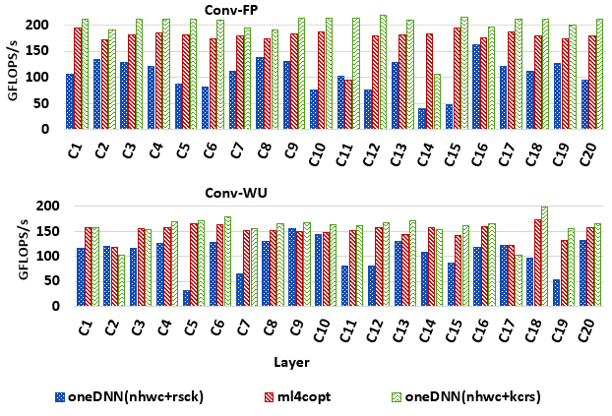
Intel OneDNN*
NHWC/RSCK |  | NHWC/KCRS
max | average | max | average
4.5x | 1.7x | 1.7x | 0.9x
NHWC/RSCK |  | NHWC/KCRS
5.4x | 1.4x | 1.2x | 1.0x
*previously known as Intel MKL-DNN

Slide 60
Intel OneDNN*
NHWC/RSCK |  | NHWC/KCRS
max | average | max | average
4.5x | 1.7x | 1.7x | 0.9x
NHWC/RSCK |  | NHWC/KCRS
5.4x | 1.4x | 1.2x | 1.0x
*previously known as Intel MKL-DNN

Slide 61
Intel OneDNN*
NHWC/RSCK |  | NHWC/KCRS
max | average | max | average
4.5x | 1.7x | 1.7x | 0.9x
NHWC/RSCK |  | NHWC/KCRS
5.4x | 1.4x | 1.2x | 1.0x
*previously known as Intel MKL-DNN

Slide 62
Related Work
Baghdadi, Riyadh, et al. "A Deep Learning Based Cost Model for Automatic Code Optimization." Proceedings of Machine Learning and Systems 3 (2021).
Zheng, Size, et al. "Flextensor: An automatic schedule exploration and optimization framework for tensor computation on heterogeneous system." Proceedings of the Twenty-Fifth International Conference on Architectural Support for Programming Languages and Operating Systems. 2020.
Chen, Tianqi, et al. "Learning to optimize tensor programs." arXiv preprint arXiv:1805.08166 (2018).

Slide 63
Conclusions

Slide 64
Conclusions
ML can be used to learn models specialized for a given transformation

Slide 65
Conclusions
ML can be used to learn models specialized for a given transformation
By isolating one transformation, we reduce the learning time and cost
Analytical heuristics are used to improve overall performance

Slide 66
Conclusions
ML can be used to learn models specialized for a given transformation
By isolating one transformation, we reduce the learning time and cost
Analytical heuristics are used to improve overall performance
The framework can be easily extended for other transformations
tile, unroll, vectorize, …

Slide 67
Conclusions
ML can be used to learn models specialized for a given transformation
By isolating one transformation, we reduce the learning time and cost
Analytical heuristics are used to improve overall performance
The framework can be easily extended for other transformations
tile, unroll, vectorize, …
Performance competitive with state-of-the-art

Slide 68
Thank You ֍ Q&A Time!

